Slide 1
01. Class Introduction
CPSC 131 ~ CSU Fullerton
Kevin A. Wortman

Slide 2
Data Structures - What Are They?
Structure for organizing data efficiently
Operations (algorithms) to observe/change data
Ex.: vector, array

Slide 3
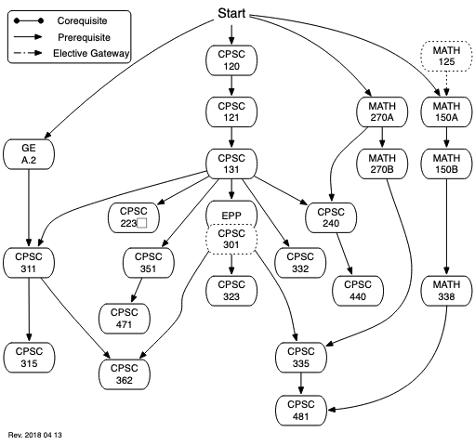
Data Structures are Foundational

Slide 4
Perspectives in this Course
Theoretical/academic
Textbook, instructor videos
Big-O efficiency
Research
Industry
Whiteboard interviews
HackerRank videos
Practical
Programming details, cplusplus.com
Empirical efficiency
Choosing which structure

Slide 5
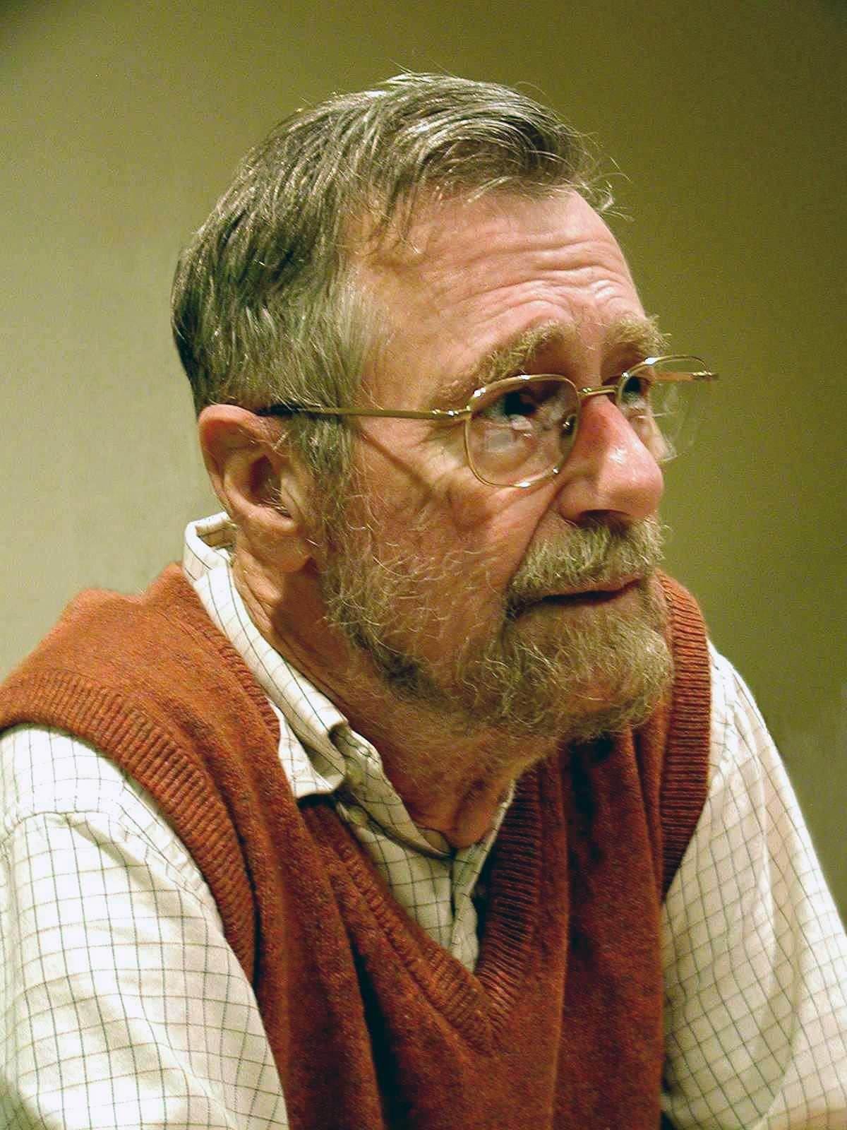
Is this a Programming Course?
“Computer science is no more about computers than astronomy is about telescopes.” - Edsger Dijkstra
CS uses programming
First: learn programming
Then: problem-solving concepts
Ex: algorithms, loops, recursion, top-down design
120-121: programming.
131: transition from “programming” to “concepts”

Slide 6
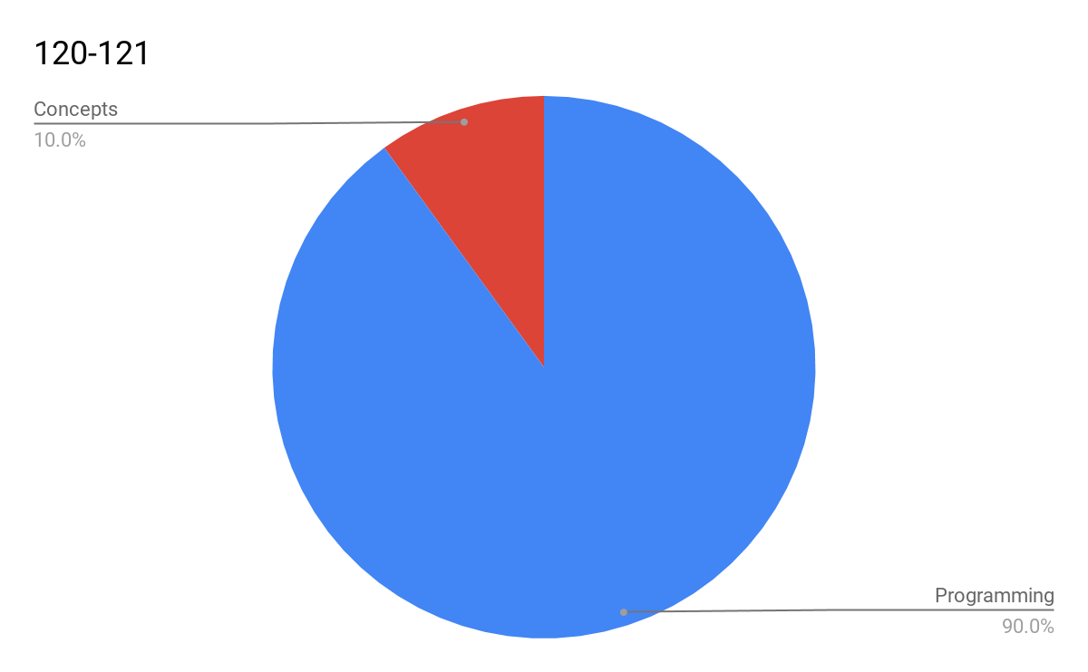
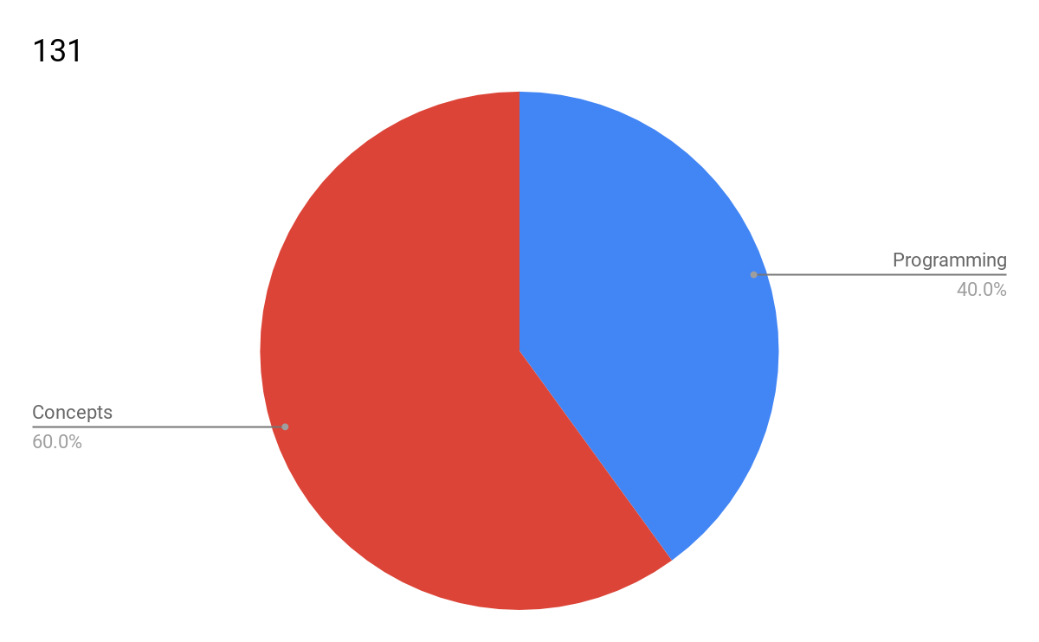
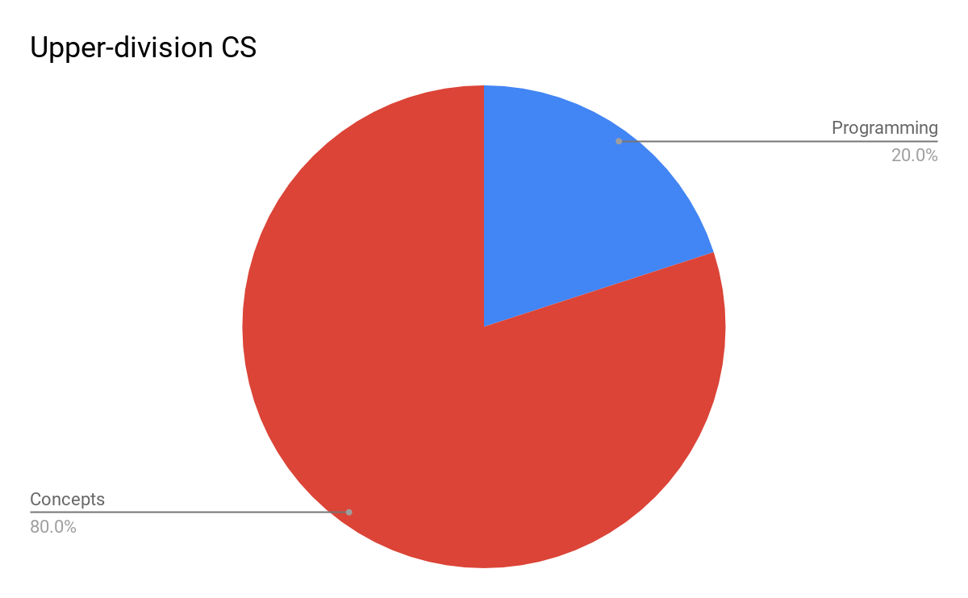
Programming vs Concepts

Slide 7
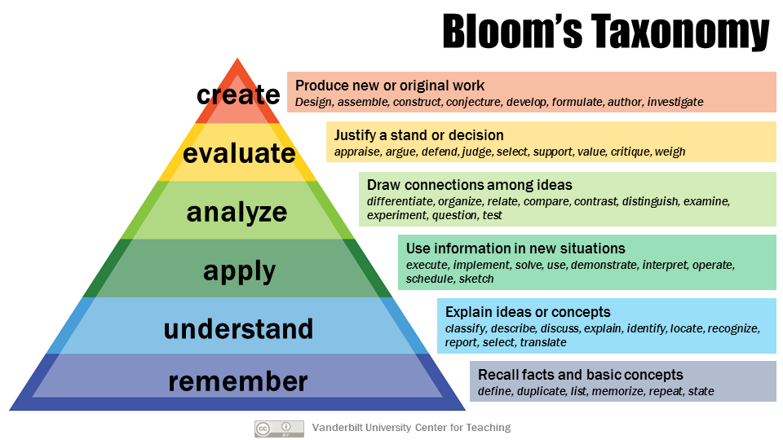
Mastering Programming
Image credit: Vanderbilt University Center for Teaching, CC-BY

Slide 8
Online, Flipped Format
In-class: active learning
Out-of-class: reading, short videos, studying
Designed to cover all of…
Theoretical (structures, big-O efficiency)
Industrial (whiteboard problems)
Practical (programming, empirical efficiency)

Slide 9
Class Agenda (after first week)
(Reading due night before class)
Announcements, Q&A
Instructor demonstration (worked example, live coding, or interactive lecture)
Team exercise
Random breakout rooms
Shared Google Doc graded for effort

Slide 10
First Week
First meeting (today)
this presentation
Second meeting (Wednesday/Thursday):
Demo: C++ review, arrays, pointers, dynamic memory

Slide 11
Semester Activities
Homework: IT setup (GitHub, Tuffix, etc.)
Midterm Exam
Canvas Quiz
TSINC in lieu of proctoring
Final Project
Programming, analysis, report
4 Projects
C++ programming
Optional groups
Dates in syllabus

Slide 12
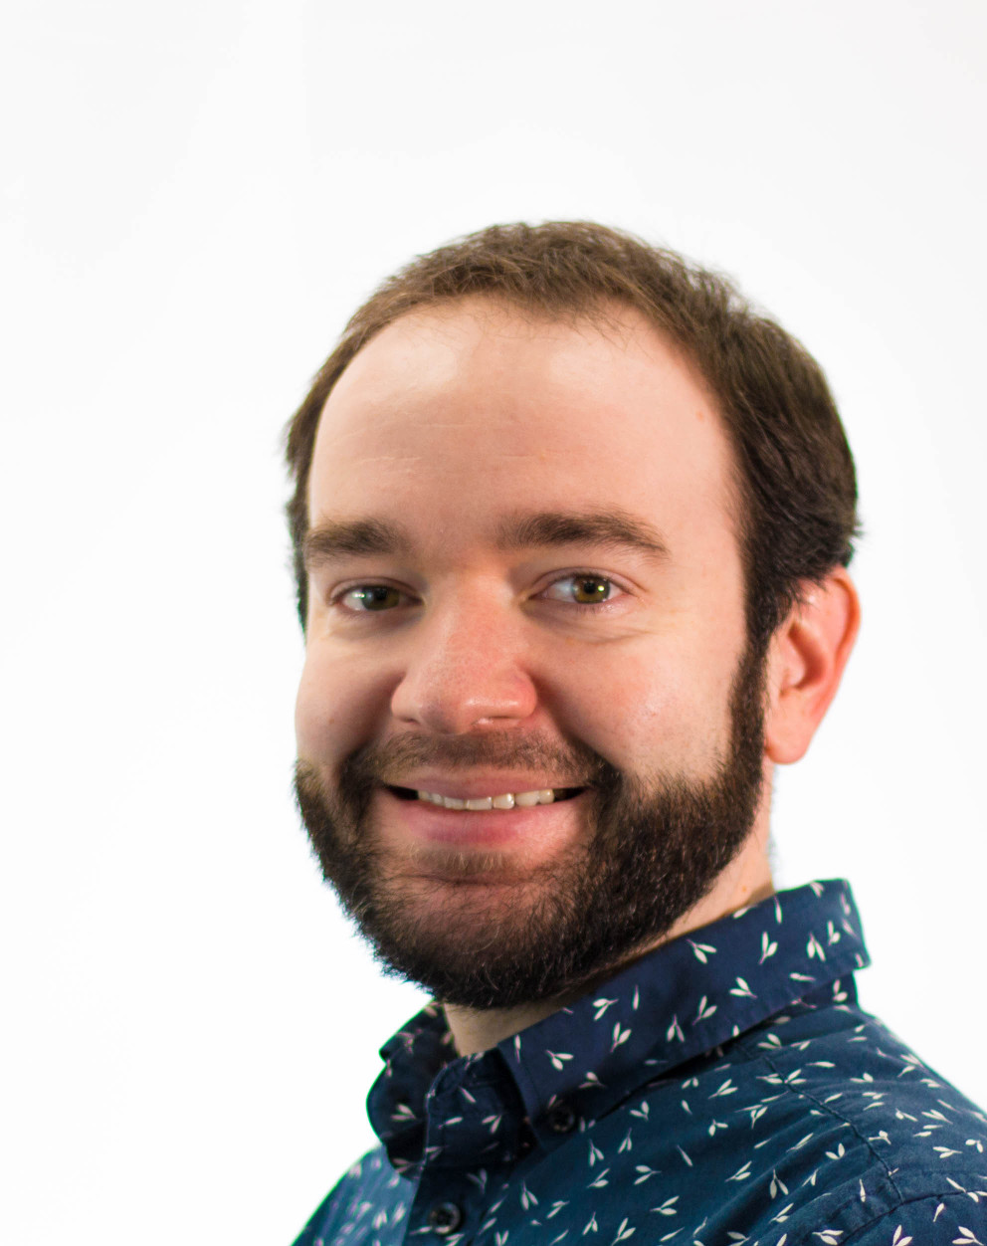
About Me
Dr. Kevin Wortman (he/him/his)
Love data structures!
Have published research papers
Have used data structures at companies (e.g. Google)

